Slide 1

CS 3450
Software Patterns
Dr. Thackeray

Slide 2
This Course
Self Directed/Instructor Guided Learning Experience

Slide 3
Connectivism Learning Theory
Informal learning is a significant aspect of our learning experience. Formal education no longer comprises the majority of our learning. Learning now occurs in a variety of ways – through communities of practice, personal networks, and through completion of work-related tasks.
Notes:
Active learning
Go over Syllabus now

Slide 4
My Background
25 years in Software/High Tech Industry
Hiring Manager
Start up & Turn around experience
15 years Technical Management
8 years post-secondary Teaching
Computer Science Faculty

Slide 5
Canvas Course (everything is in Canvas)
Schedule
Assignments, Programming Projects and Exams
Reading Assignments
Class
Lecture
Design & Code reviews
In-class (streaming) Team assignments
Lab time
Notes:
Demo: Go over syllabus and canvas course

Slide 6
About This Course
It is a course on Software Design
More specifically, Physical Design
What happens after Conceptual Design
We talk about entities (classes) and their relationships
We will emphasize Design Patterns
Object-oriented solutions to commonly-occurring software design problems
The solutions are not code – they can be applied in many different contexts in any OO language

Slide 7
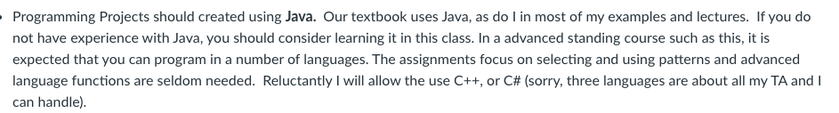
Assignments

Slide 8
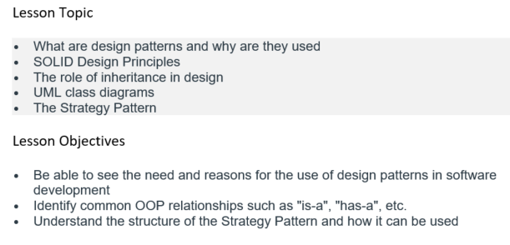

Slide 9
Physical Software Design
The mapping from solution concept to implementation
The proverbial “rubber meeting the road”
This trips up many developers
Just ask those who have taken the Compiler Course
The Composite Pattern is handy for syntax trees

Slide 10
Software’s Dirty Little Secret
Real world software is messy!
Why?
These principles and patterns will help you make your software less messy
IF you use them
They are guaranteed not to remove all the mess!

Slide 11
Software Design Messes
Classes
Can add gratuitous conceptual overhead
Inheritance
Can make it hard to figure out what’s going on
Data
How did it get that value?
Performance
External factors can cause inconsistent performance
Concurrency
Possible race conditions
Size
How big a program can you completely understand?
Notes:
Gratuitous - uncalled for; lacking good reason; unwarranted.

Slide 12
… and Then There is Maintenance
Just figuring out what the program does
Changes in one place have impact elsewhere (that you didn’t expect)
You may have to make many changes for a single enhancement
Most of you will maintain code
Most of you will have to extend code
Notes:
Extensibility
maintainability

Slide 13
Structure and Behavior
(Or static vs. dynamic design)
Structure: How you lay out your classes
Behavior: What happens when the program runs
You need to design both
But of course, they are interdependent
There are patterns for both

Slide 14
DRY
What does this stand for?
It is probably the most fundamental principle of software design, and leads to a number of Good Practices (as we shall see)
Notes:
Don’t Repeat Yourself or Cut & Paste pattern
Design Principle

Slide 15
About Design Patterns
The biggest Cool Thing to hit software development since OO Technology
Enables developers to effectively respond to change
Changes in requirements
Changes in implementation
Efficiency improvements, for example
… without adversely affecting clients of their code
Evolved naturally from applying sound design principles to OO
e.g., separate interface from implementation
e.g., seek high cohesion, loose coupling

Slide 16
Benefits of Design Patterns
Reuse of Thoughtware
Not code
Because your problem may be similar to, but not quite the same as a previously solved problem—yet the thinking applies
Saves reinvention of design
Imparts expertise to non-experts
Gives you a vocabulary of catalogued solutions
“Let’s do a Bridge here”
“This looks like a natural situation for Strategy”
Higher context language – more conceptual level

Slide 17
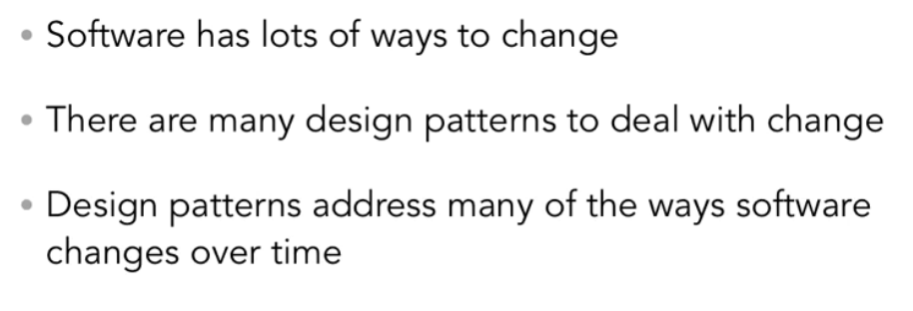
Dealing With Change

Slide 18
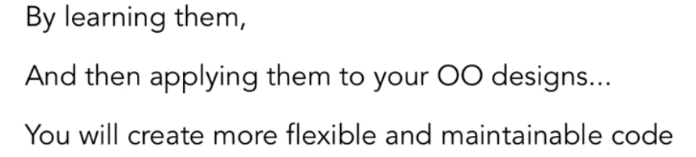
Design Patterns

Slide 19
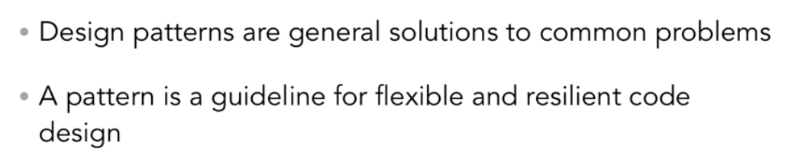
Dealing with Change

Slide 20
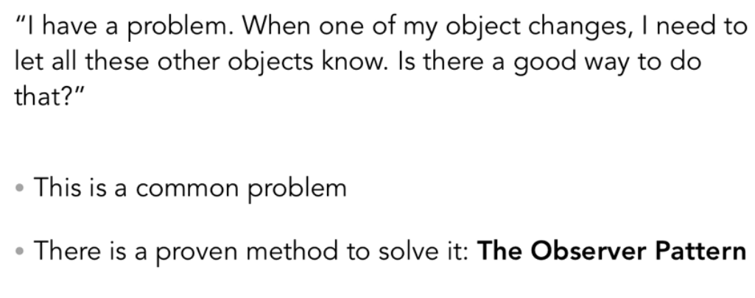
Example

Slide 21

Christopher Alexander
Building Architect
1976: “A Pattern Language”
Over 200 patterns
His Definition:
A Problem
A System of Forces
A Solution

Slide 22
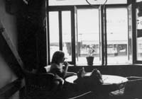
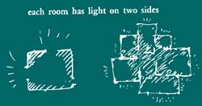

Light on two sides of every room

Slide 23
Patterns in Software
OO Designs (Most famous)
Language-Specific (Idioms)
C++: Copy constructor and = operator
Copy-on-Write (CoW)
Architecture
People, organizations, project management (Scrum)
Security
User interface
Many others
Differences in Scale
Notes:
Idioms = a group of words established by usage as having a meaning not deducible from those of the individual words (e.g., rain cats and dogs, see the light ).

Slide 24
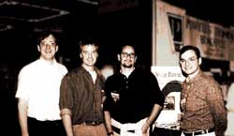
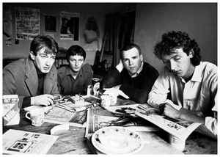
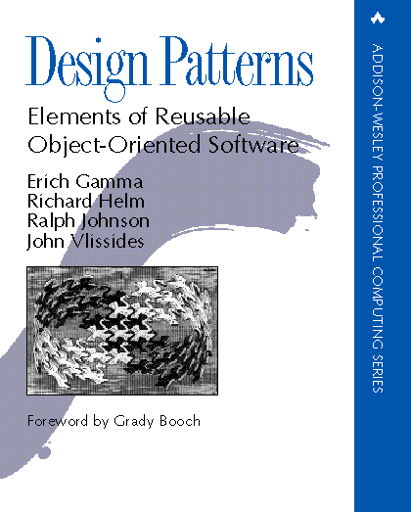
Gang of Four
Notes:
Not the English punk rock band
2 Float ins
Design Patterns: Elements of Reusable Object-Oriented Software is a software engineering book describing software design patterns. The book's authors are Erich Gamma, Richard Helm, Ralph Johnson and John Vlissides with a foreword by Grady Booch.
October 21, 1994 – I was well into my career

Slide 25
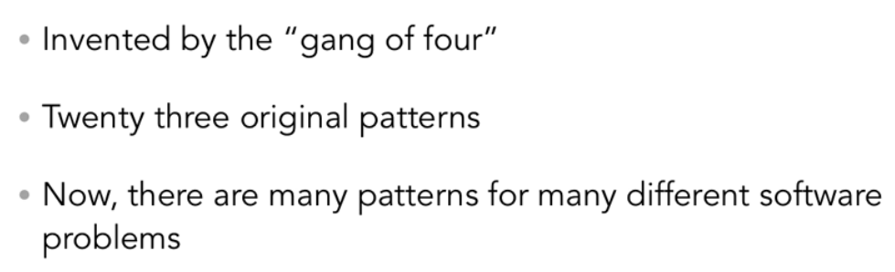
Gang of Four

Slide 26
The Gang of Four: Pattern Catalog
Creational Abstract Factory Builder Factory Method Prototype Singleton Structural Adapter Bridge Composite Decorator Façade Flyweight Proxy | Behavioral Chain of Responsibility Command Interpreter Iterator Mediator Memento Observer State Strategy Template Method Visitor
-ParamiSoft Systems Pvt. Ltd.

Slide 27

All you have to do is learn how to sling code right?
Notes:
Draw schedule time line
Time spent in design is worth it:
scalability deals with how the application can grow or shrink. Extensibility deals with how other people, systems, etc. can take the existing code and add on to it without affecting the base

Slide 28
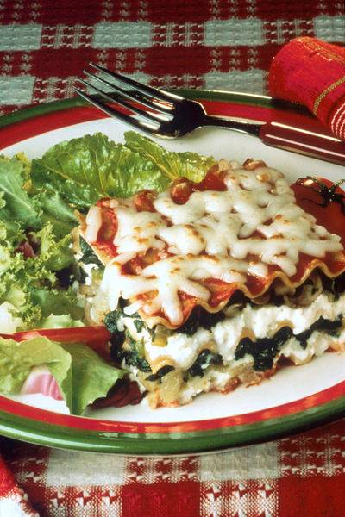
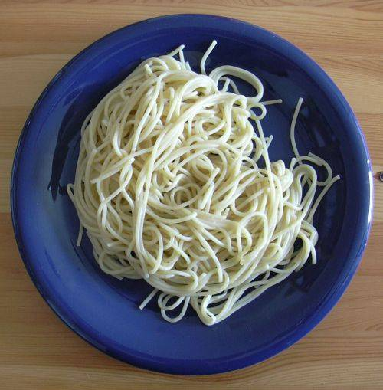
Does Design Make a Difference?

Slide 29
Principles of Software Design
What makes a good software design?
Understandability
Extensibility
Simplicity
Elegance
Maintainability
Robustness
Etc.

Slide 30
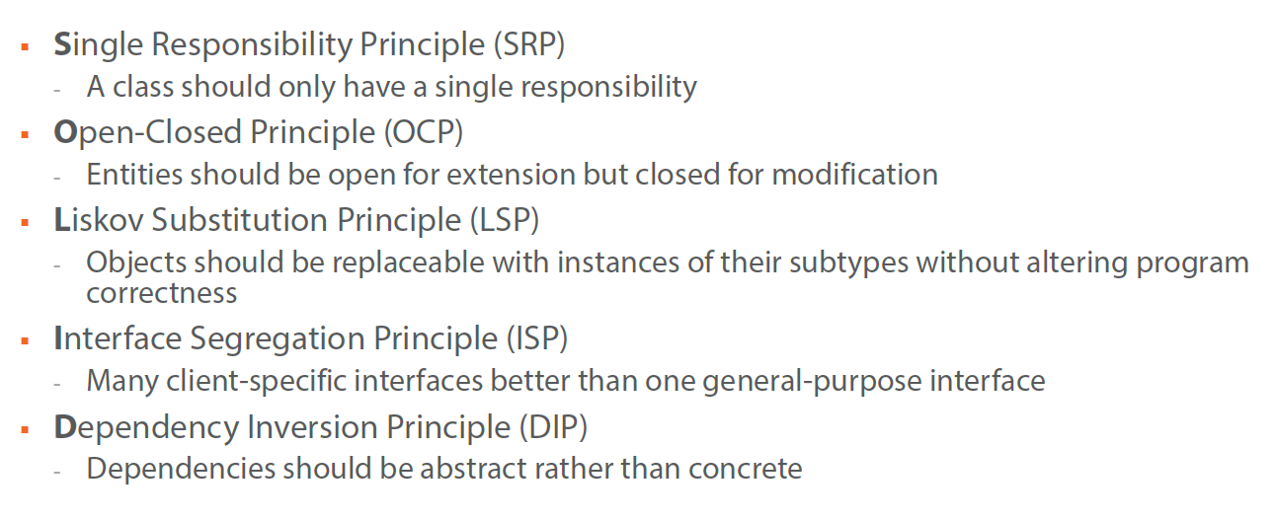
SOLID Design Principles
Robert C. Martins (“Uncle Bob”)
Notes:
This is often an interview question

Slide 31
Good Design
Notes:
Design patterns are part of a well designed solution
Principles ->patterns
High cohesion is a software engineering concept that refers to how closely all the routines in a class, or all the code in a routine, support a central purpose. Classes that contain strongly related functionalities are described as having high cohesion;
Low coupling refers to a relationship in which one module interacts with another module through a simple and stable interface and does not need to be concerned with the other module's internal implementation

Slide 32
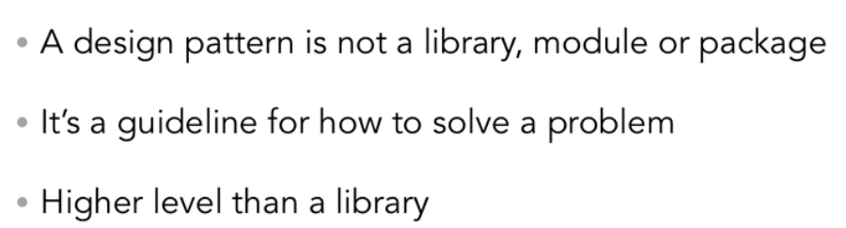
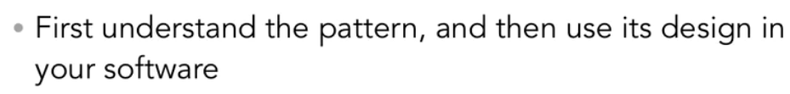
Using Design Patterns
Notes:
Float in
Shared vocabulary

Slide 33
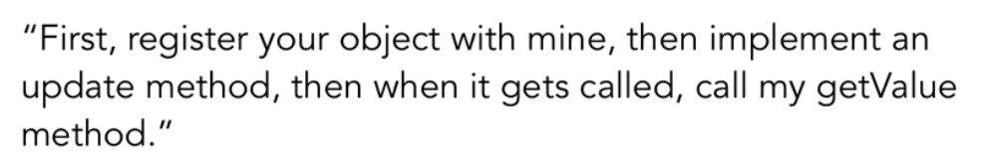
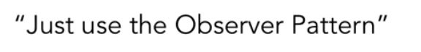
Shared Vocabulary
Notes:
Float in

Slide 34
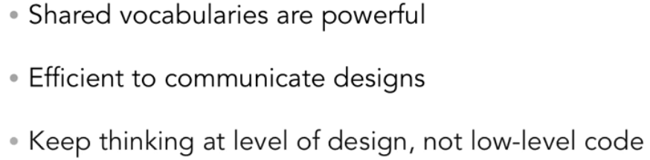
Design Patterns

Slide 35
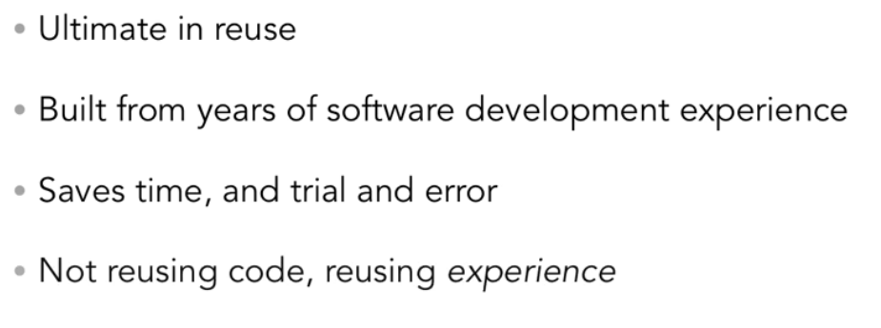
Design Patterns

Slide 36
Inheritance
The chief benefit of inheritance is in design
And design is conceptual
It helps us think about the problem and solution
Code sharing (e.g., virtual methods) is just a bonus

Slide 37
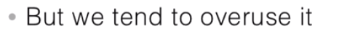
Inheritance
A dog IS-A canine
Notes:
float in
Now typically you think of one class inheriting from the other if they share an is-a relationship. --- For instance if a dog is a canine then a dog should inherit from the canine class. And then we can extend this further with other types of canines. --- In each case, we're using the implementation of the classes we inherit from. --- This is a powerful technique, and there are many designs where inheritance is exactly the right choice. --- But it's also easy to overdo inheritance, and make it the basis for all object-orient design. In fact, it's easy to treat inheritance as a hammer, making every design look like it needs super classes and subclasses your nails.
So something you should pay attention to, when all your class relationships and your designs are is-a relationships, it's time to take a closer look at your overall design. - Why? when you overuse inheritance, you can end up with designs that are quite inflexible and not amendable to change.

Slide 38
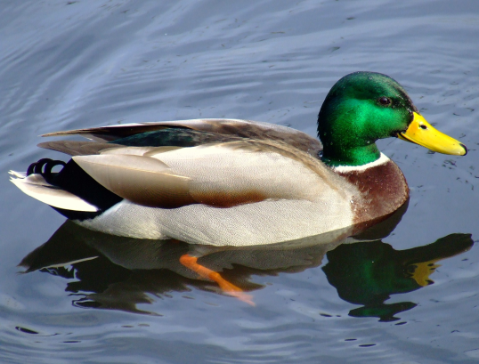
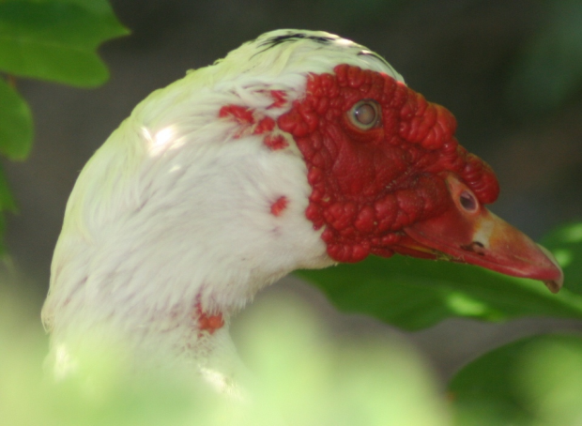
Example: Initial Class Diagram
Notes:
design a duck simulator--- start with a duck super class. ---You might give the superclass a quack method, a swim method, because those are the things that you guess all ducks are going to want to do.---- give it a display method. But we'll keep that abstract, because each duck will want to implement its own visual look. --- because display is abstract, that makes our duck class abstract too, meaning that we can't instantiate a duck directly. -- add concrete classes

Slide 39
A Good Start
We figured out that Duck is abstract, and it holds what is shared by all Duck types
We override what is polymorphic
As we continue our analysis, we note that ducks must also fly
It doesn’t matter that we didn’t think of that from the outset
We must continually adapt our design

Slide 40
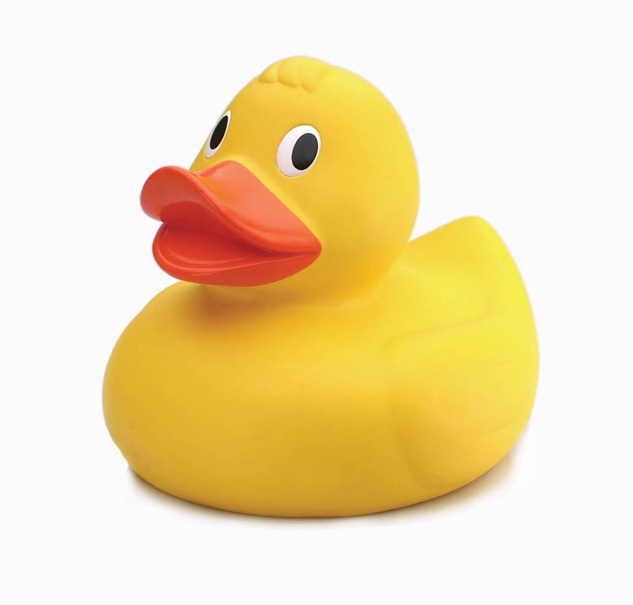
Feature Request
We now need to support Rubber Ducks
They squeak instead of quack
No problem, we’ll override quack( )
So, we add this class…

Slide 41
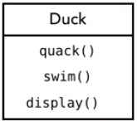
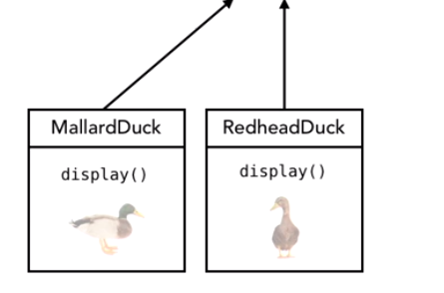
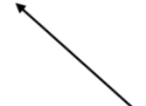
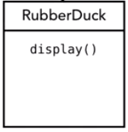
Example: Duck Simulator
Notes:
Now ask yourself what happens sooner or later in every object-oriented design? --- The unexpected of course. --We need to add additional ducks --. Rubber Ducks don’t quack --- But we can handle that by overriding the quack method and making the rubber duck squeak

Slide 42
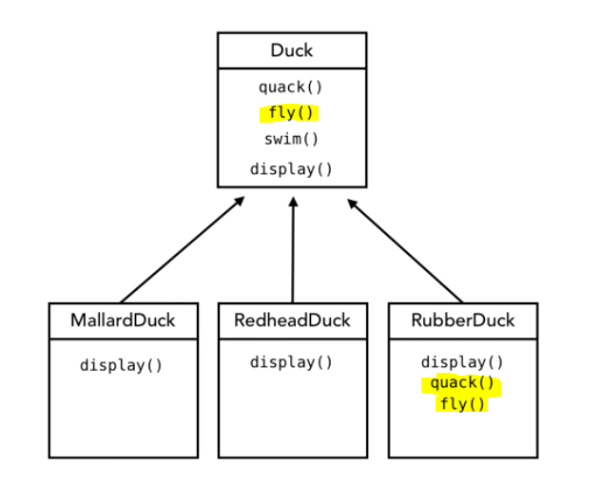
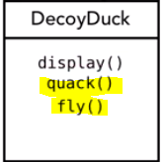
Add flying
Notes:
Another Feature request -- Add more ducks (decoy) ---So we need to fix rubber & decoy duck again by overriding the fly method. ---- And then we'll add some code to make sure that the rubber & decoy duck does nothing (no op) in the method when it's called.

Slide 43
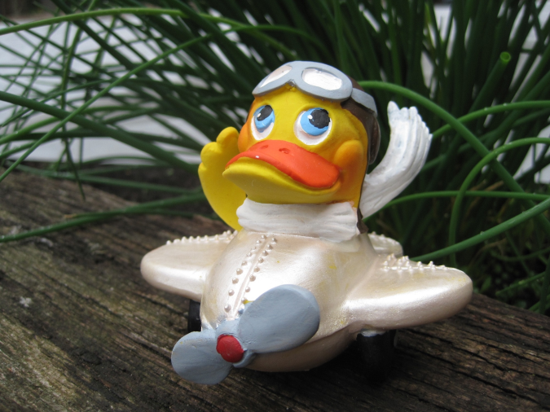
How Are We Doing?
Rubber Ducks don’t fly!
How are we going to correctly fit Rubber Ducks into the hierarchy?
We could override RubberDuck.fly( ) to do nothing

Slide 44
Evaluating the Design
Advantages:
Easy to do!
Didn’t have to change the base class!
Disadvantages?
Reading the code: opportunity for confusion
(It violates a programming principle we will learn later)

Slide 45
Problems with Our Design
Not getting a good reuse benefit from classes
Getting a little messy and Kludgy (code stink)
Code duplication across classes
Hard to gain knowledge of all the ducks (from abstract class)
Change in Super Class can have side affects on subclasses (fly)
Runtime Behaviors changes are difficult
Notes:
Not a huge benefit from inheritance -- We can’t look at our super class and cannot get a lot of direct knowledge. --- We really have to go into each concrete class to learn more about the code does. --- changes to super class (fly) affect other ducks (side affect) -- Runtime Behaviors are assigned a compile time (hard to change, ie: injured, captured)

Slide 46
Remember: “Embrace Change”
Adding no-op methods ad nauseum for new classes doesn’t feel quite right, or does it?
What happens when we add DecoyDuck
Which neither flies nor quacks
We get operation “holes” in our hierarchy
Which is a form of code duplication (violates DRY)

Slide 47
Inheritance is not The Answer
Not everything we’ve put in the Duck class should be inherited
Some ducks don’t fly, etc.
Inheritance is specified statically (before runtime)
It is too rigid to easily accommodate change like this
We must change code

Slide 48
Insight
Principle!!!
Encapsulate what varies and separate it from the rest of your code
Reduces coupling among classes
Reduces chances of duplicating code later on
What does this mean, exactly?
Notes:
High cohesion is a software engineering concept that refers to how closely all the routines in a class, or all the code in a routine, support a central purpose. Classes that contain strongly related functionalities are described as having high cohesion;
Low coupling refers to a relationship in which one module interacts with another module through a simple and stable interface and does not need to be concerned with the other module's internal implementation

Slide 49
Design Principle
“Identify the aspects of your application that vary and separate them from what stays the same.”
You decide what varies and what doesn’t
Not cast in stone
This principle underlies most patterns
Notes:
What varies: quack, fly

Slide 50
Separating What Varies
Let’s see what happens if we encapsulate Flying and Quacking behaviors in their own classes
In other words, the implementations of these behaviors go into their own respective hierarchies
There still needs to be something in Duck that ultimately invokes these behaviors, of course
That is, the interface is still there

Slide 51
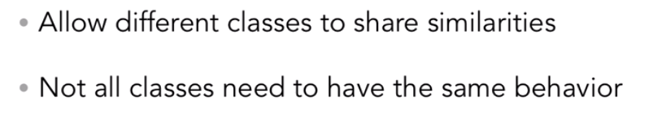
Using Interfaces?
Notes:
Lets refactor and move duck behavior into interfaces
Interface: contract, no executable code, cannot instantiate

Slide 52
Design Principle
“Program to an interface, not an implementation”
Principle!!!
An interface is an API or contract
Interface can be abstract class
all inheritances should be an interface or abstract class
Notes:
Interface can be abstract class – all inheritance should be from interface or abstract class

Slide 53
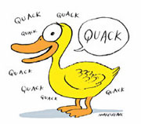
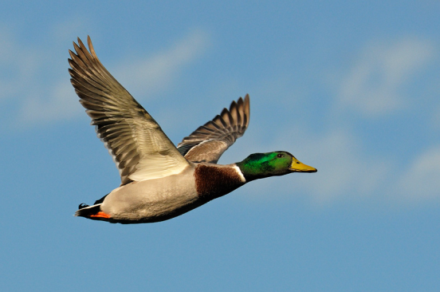
The Varying Behaviors
Notes:
New interfaces

Slide 54
Benefits of This Design
We can add new behaviors without affecting the Duck class
Simple polymorphism does this too, but this design puts the behaviors in a single place (DRY!)
Also, these classes are independent of Duck and can be used in other contexts
Notes:
Open / Closed Principle

Slide 55
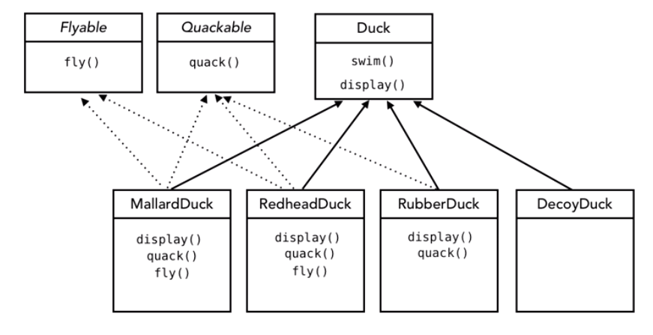
Implementing Interfaces
Notes:
What is wrong with this design?

Slide 56
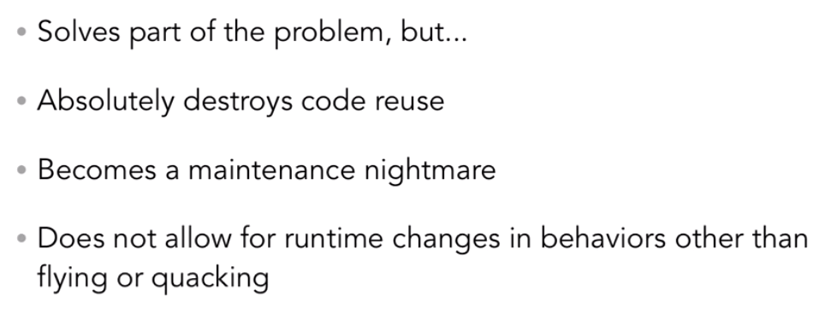
This Design is Also Problematic

Slide 57
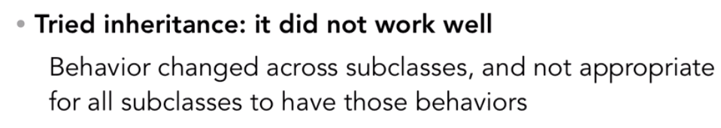
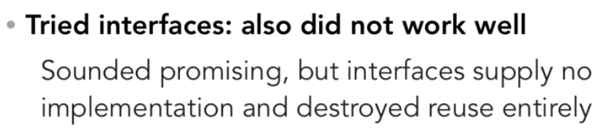
Review Our Attempts
Notes:
Float in
So, where do we go from here? Has OOP failed us?
No, we need to go a little farther and apply some design principles

Slide 58
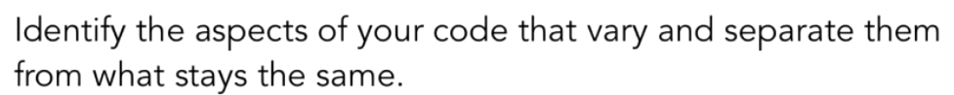
Design Principle #1

Slide 59
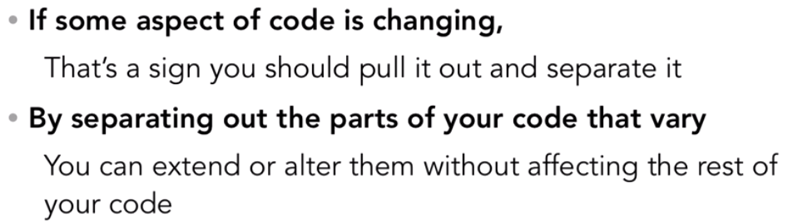
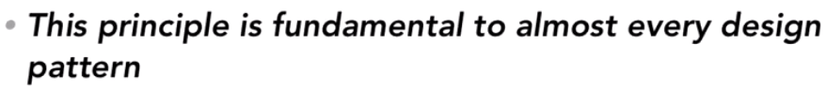
Encapsulate What Varies
Notes:
Float in

Slide 60

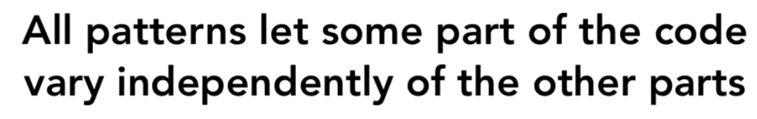
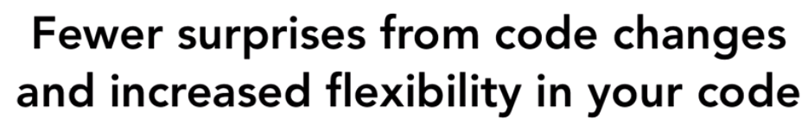
Notes:
Float in
Change is the only constant in software design. --- Software always changes so you might as well be ready for it.

Slide 61
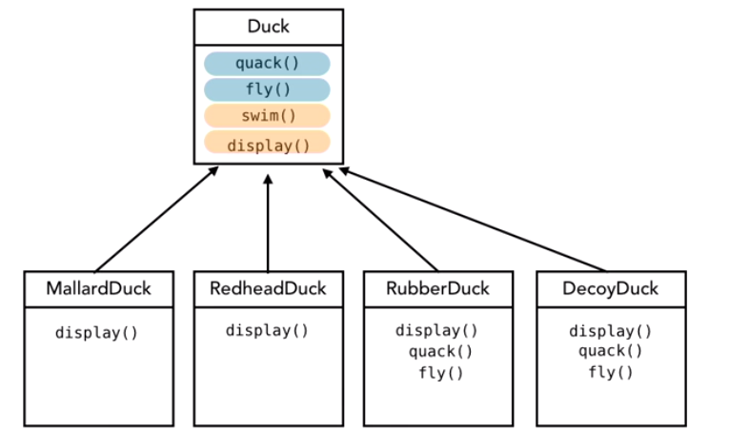
Identify What Changes
Notes:
What Changes: quack and fly

Slide 62
Design Principle #2
Notes:
Next slide -Identify what changes

Slide 63
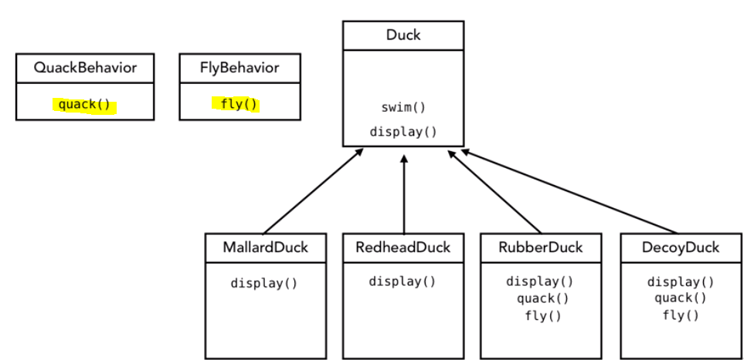
Identifying What Changes (and separate it)

Slide 64
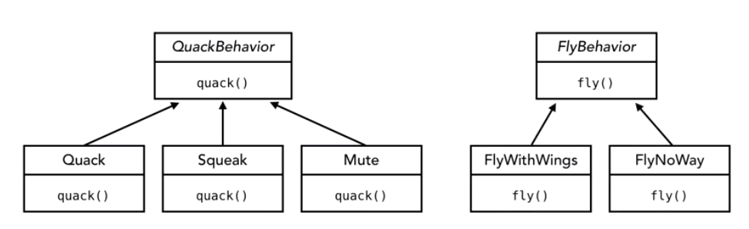
Programming to an Interface
Notes:
Quackbehavior and flybehavior are interfaces

Slide 65
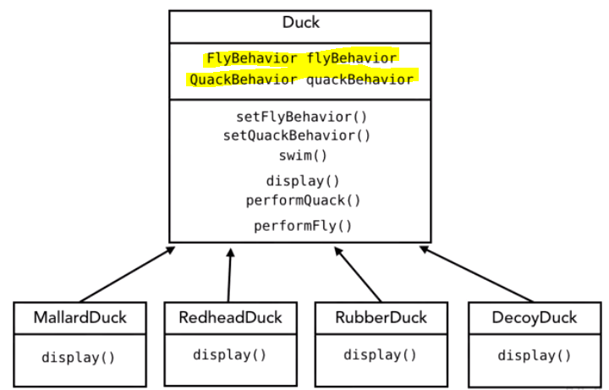
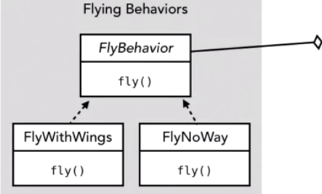
Programming to an Interface
Notes:
Composition = “has a” relationship
This is the UML diagram for the strategy pattern. --- The context receives a request and it decides which strategy to use based off of the situation. --- Strategies all adhere to the same interface. --- And then, finally, the concrete implementations are then selected based off the situation. --- Each strategy is contained within its own class.

Slide 66
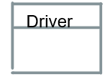




Typical UML for Strategy
Calls object methods
Selects Algorithm
Notes:
This is the UML diagram for the strategy pattern. --- The context receives a request and it decides which strategy to use based off of the situation. --- Strategies all adhere to the same interface. --- And then, finally, the concrete implementations of which there may be many are then selected based off the situation. --- Each strategy is contained within its own class. --- In this case the different duck types are the algorithms (doesn’t change), strategy is the context (fly and quack options)
Demo Code: PatternStrategy (intellij) or strategyCsharp

Slide 67



Principles in Strategy

Slide 68

Programming to an Interface

Slide 69

Programming to an Interface
Notes:
Code demo: PatternStratagy

Slide 70


Slide 71


Review What we have Done
Notes:
Float in

Slide 72


Design Principle #3
Inheritance

Slide 73

Design Principle #3
Composition
Notes:
It describes a class that references one or more objects of other classes in instance variables. This allows you to model a has-a association between objects.

Slide 74

Association, Composition and Aggregation

Slide 75

Association

Slide 76


Slide 77

Aggregation
Notes:
t's important to note that the aggregation link doesn't state in any way that Class A owns Class B nor that there's a parent-child relationship (when parent deleted all its child's are being deleted as a result) between the two. Actually, quite the opposite! The aggregation link is usually used to stress the point that Class A instance is not the exclusive container of Class B instance, as in fact the same Class B instance has another container/s.

Slide 78

Composition

Slide 79


Slide 80

Strategy Pattern

Slide 81

Strategy
Notes:
This is the UML diagram for the strategy pattern. The context receives a request and it decides which strategy to use based off of the situation. Strategies all adhere to the same interface. And then, finally, the concrete implementations of which there may be many are then selected based off the situation. Each strategy is contained within its own class.

Slide 82

Strategy Pattern When to Choose it
Notes:
The concepts surrounding why you would choose the strategy pattern are that you want to or see the need to eliminate conditional statements in your application. The strategy pattern encapsulates the algorithm options and individual classes that eliminate the conditional statements in your application. Another key point of when you would choose the strategy is if it's difficult to add new strategies or cases inside your application. When using this pattern, the client is typically aware of the strategies that are available and usually chooses the strategy that we are ultimately going to use in our application. A great example of this pattern in the Java API is java.util Comparator. The comparator is used when we want to implement various comparison strategies in our application for passing into a sort method. Let's look at the design of the strategy pattern now.

Slide 83

Design
Notes:
The design of the strategy can be implemented with an interface, but typically it is utilizing an abstract base class. All of the concrete classes are then implemented per strategy, where each concrete class will then implement the algorithm that is unique to that strategy. A key point with the strategy pattern is that we want to minimize, if not eliminate, if/else conditionals from our application. A key point with the design of this pattern is that the client knows about the strategies, but other strategies don't necessarily know about each other. The pieces of the UML diagram are a context, strategy, and concrete strategy implementations. Let's look at that UML diagram now.

Slide 84

Strategy Example
Notes:
Could do activity now if there is time

Slide 85


Summary
Notes:
Float in: issues

Slide 86

Intellij UML Generation
Notes:
Right click on package (under src)
Select diagrams (at bottom of list)
Select “java class diagram”

Slide 87


Intellij JavaDocs Generation
Notes:
Float in
Tools->Generate Java Docs

Slide 88

Visual Studio: UML Diagram
Notes:
Have to scroll down

Slide 89

Visual Studio: UML Diagram

Slide 90

Visual Studio: UML Diagram

Slide 92
How to use Patterns OO Design 101
How does one use Object-oriented technology to design a software system?
What were you taught in CS 1410?

Slide 93
OO Design 101
Look for nouns
Good candidates for classes/objects
Then, what are these objects responsible for?
Good candidates for methods
Then, look for relationships among types of objects
Is-a, Has-a, Uses, etc.

Slide 94
Finding the Classes and Their Responsibilities in a Problem
One of the first steps when designing an object-oriented program is finding the classes that should be created and determining those classes’ responsibilities in the program.

Slide 95
Over the years, software professionals have developed numerous techniques for finding the classes in a given problem. One simple and popular technique involves the following steps:
Get a written description of the problem domain
Identify all the nouns (including pronouns and noun phrases) in the description. Each of these is a potential class
Refine the list to include only the classes that are relevant to the problem

Slide 96
Step 1: Description of problem
Joe’s Automotive Shop services foreign cars, and specializes in servicing cars made by Mercedes, Porsche, and BMW. When a customer brings a car to the shop, the manager gets the customer’s name, address, and telephone number. The manager then determines the make, model, and year of the car, and gives the customer a service quote. The service quote shows the estimated parts charges, estimated labor charges, sales tax, and total estimated charges.

Slide 97
Step 2: Identify the Nouns
Joe’s Automotive Shop services foreign cars, and specializes in servicing cars made by Mercedes, Porsche, and BMW. When a customer brings a car to the shop, the manager gets the customer’s name, address, and telephone number. The manager then determines the make, model, and year of the car, and gives the customer a service quote. The service quote shows the estimated parts charges, estimated labor charges, sales tax, and total estimated charges.

Slide 98


Slide 99

Step 3: Refining the list of Nouns
Some Nouns mean the same thing

Slide 100


Some Nouns represent items we do not need to be concerned with

Slide 101

Some Nouns represent objects, not classes

Slide 102

Some Nouns might be simple values that can be stored in a regular variable and do not require a class

Slide 103
list of nouns
Cars
Customer
Service Quote

Slide 104
Determining Class Responsibilities
The next step is to determine those classes’ responsibilities. A class’s responsibilities are as follows:
● The things that the class is responsible for knowing
● The actions that the class is responsible for doing
When you have identified the things that a class is responsible for knowing, then you have identified the values that will be stored in fields.
Likewise, when you have identified the actions that a class is responsible for doing, you have identified its methods
Notes:
Properties and behaviors

Slide 105
Determining Class Responsibilities
It is often helpful to ask the questions “In this program, what must the class know? What must the class do?” The first place to look for the answers is in the description of the problem domain.

Slide 106
Customer Class
In this program, what must the Customer class know? The problem domain description directly mentions the following items:
● The customer’s name
● The customer’s address
● The customer’s telephone number
Notes:
properties

Slide 107
Customer Class
Now, let’s identify the class’s methods. In this program, what must the Customer class do? The following are the only obvious actions:
● Create an object of the Customer class
● Set and get the customer’s name
● Set and get the customer’s address
● Set and get the customer’s telephone number
From this list, we can see that the Customer class will have a constructor, as well as accessor (GET) and mutator (SET) methods for each of its fields.

Slide 108

UML diagram for the Customer class

Slide 109
Car Class
In this program, what must an object of the Car class know? The following items are all attributes of a car, and are mentioned in the problem domain:
● the car’s make
● the car’s model
● the car’s year

Slide 110
Car Class
Now let’s identify the class’s methods. In this program, what must the Car class do? Once again, the only obvious actions are the standard set of methods that we will find in most classes (constructors, accessors, and mutators). Specifically, the actions are as follows:
● create an object of the Car class
● set and get the car’s make
● set and get the car’s model
● set and get the car’s year

Slide 111

UML diagram for the Car class

Slide 112
Service Quote Class
In this program, what must an object of the ServiceQuote class know? The problem domain mentions the following items:
● the estimated parts charges
● the estimated labor charges
● the sales tax
● the total estimated charges

Slide 113

UML diagram for the Service Quote class

